Slide 1

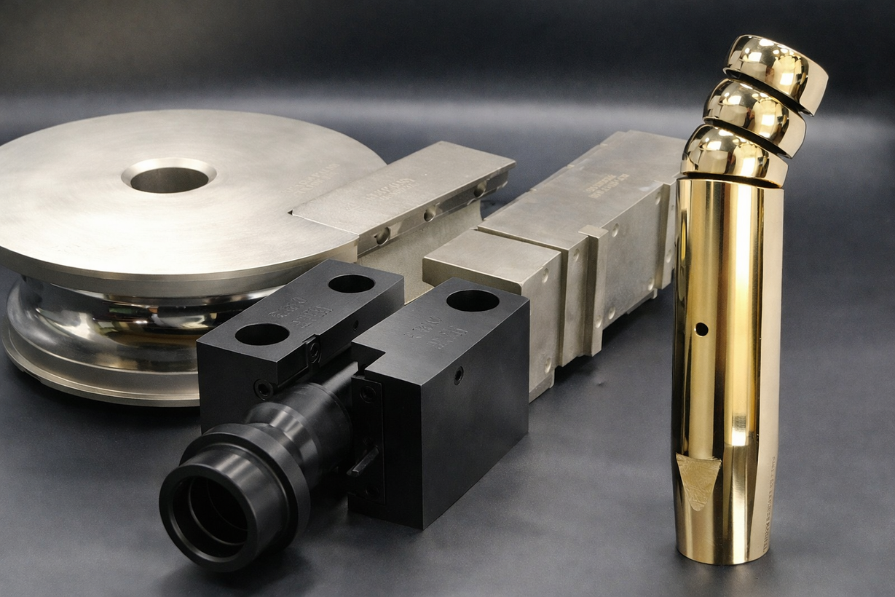
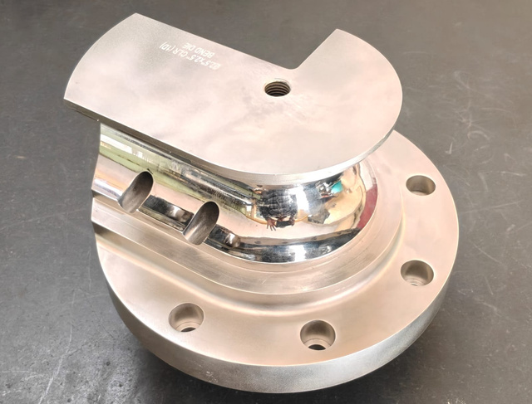

VINSAT
PRECISION
TECHNOLOGIES Email: Info@vptpune.com
Elevate Your Business with Us
About Us
Our company specializes in providing highly precise tube/pipe bending tooling.
Our scope is from Feasibility study, Design, manufacturing and Proving out the tool on machine.
Why Choose Us?
At Vinsat Precision Technologies, we offer innovative one stop tooling solutions backed by over 3 years of experience in pipe bending. Choose us to help your company achieve new heights of excellence.
Our Services
Feasibility study
Design the Bending tools
Manufacturing the tools
Prove out of the tool
Aerospace
Automotive
Furniture
info@vptpune.com
+91 9764996161
Bhosari MIDC, Pune 411026

Slide 2
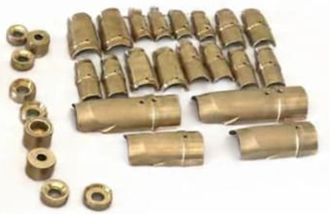
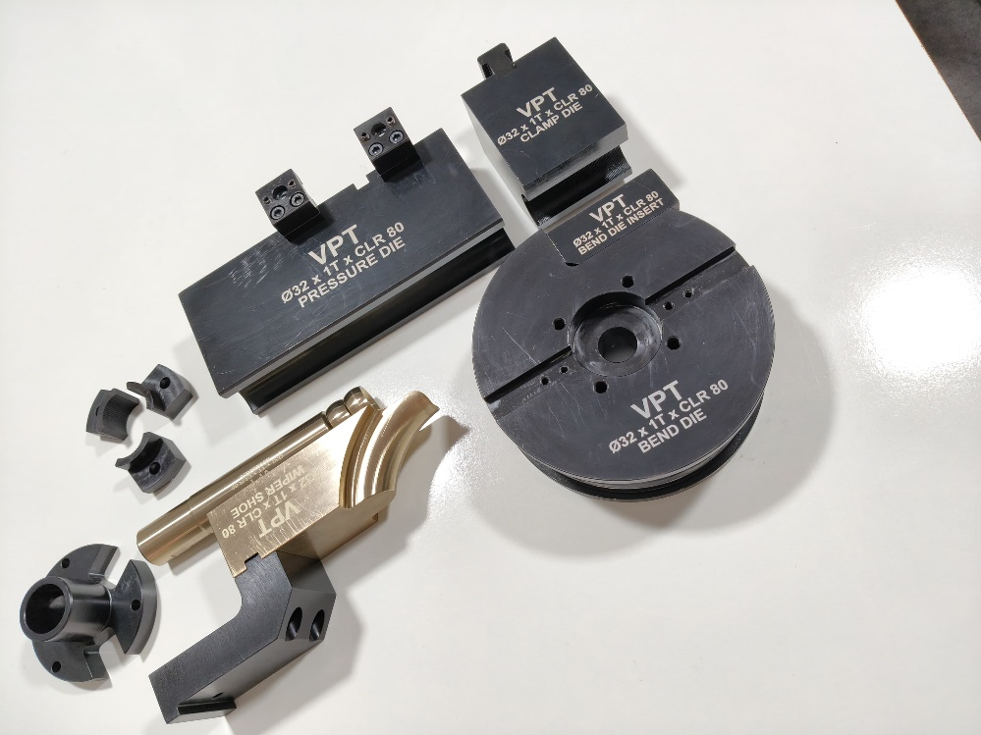
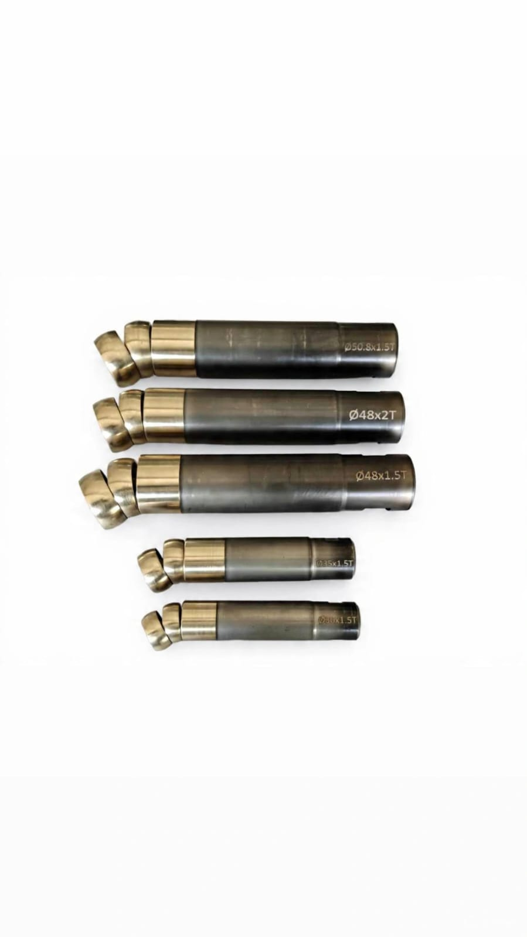
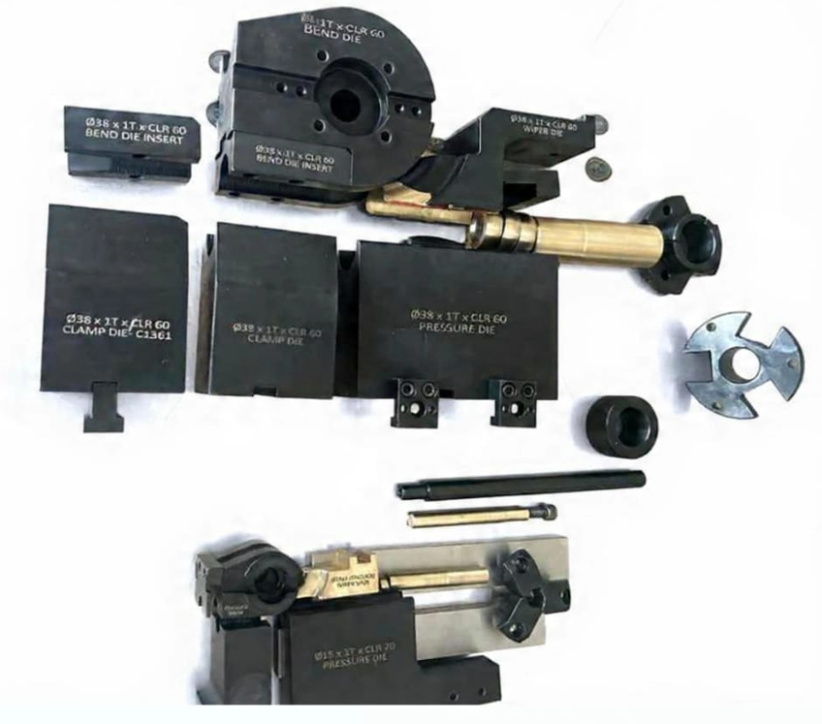
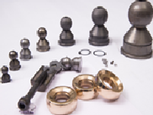
VINSAT
PRECISION
TECHNOLOGIES Email: Info@vptpune.com
Images of supplied tooling's
info@vptpune.com
+91 9764996161
Bhosari MIDC, Pune 411026

Slide 3
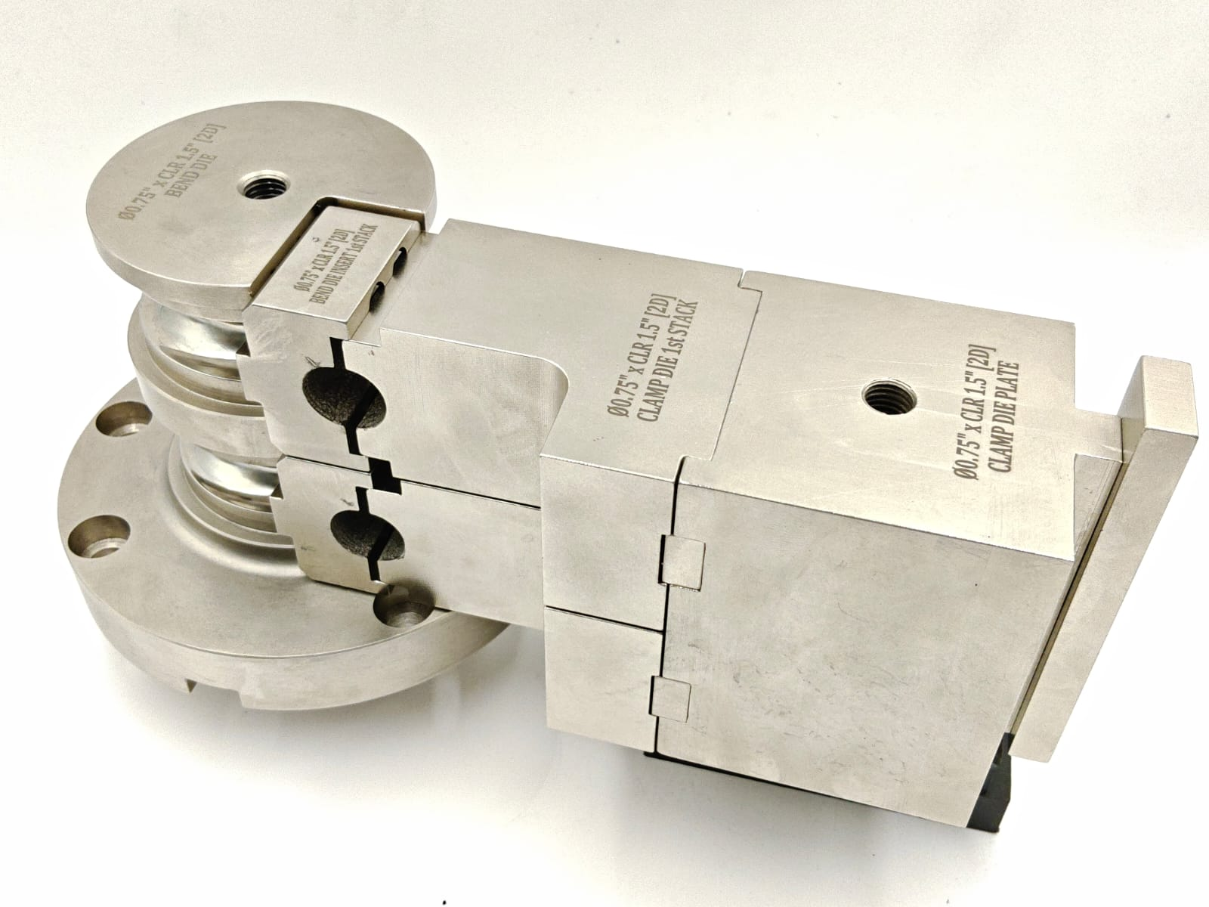
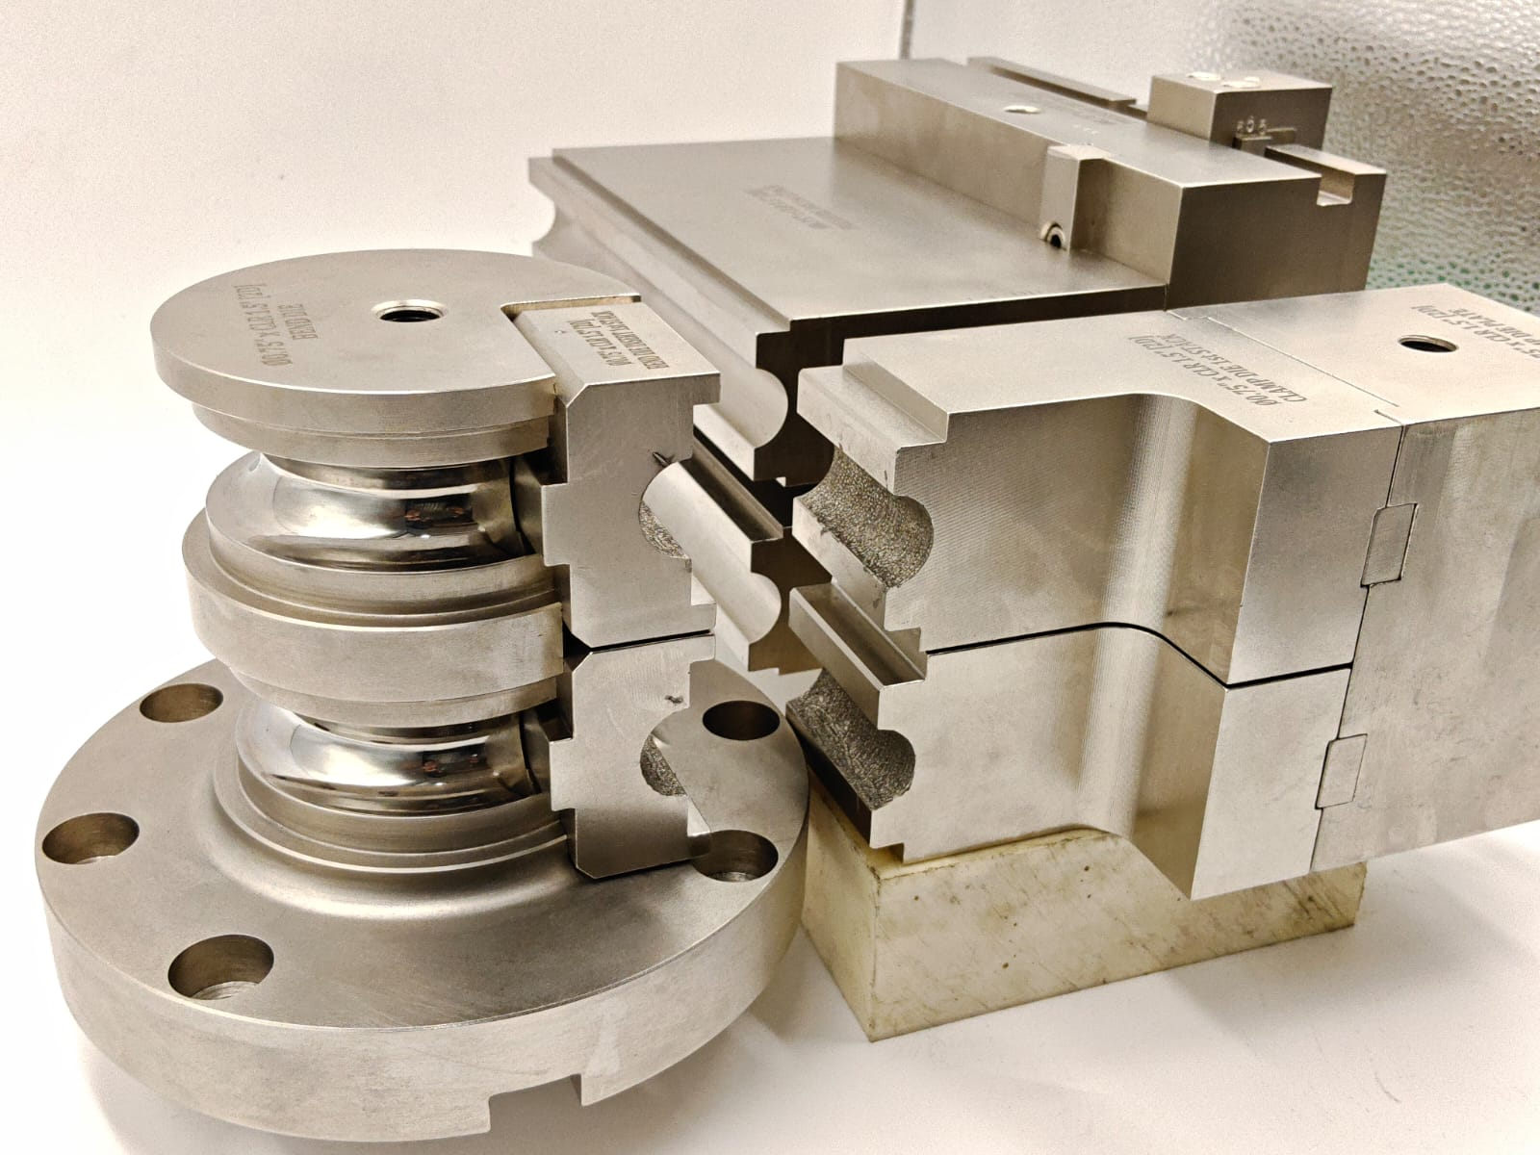
VINSAT
PRECISION
TECHNOLOGIES Email: Info@vptpune.com
Images of supplied tooling's
info@vptpune.com
+91 9764996161
Bhosari MIDC, Pune 411026

